Slide 1
Handwritten Number Recognition

Slide 2
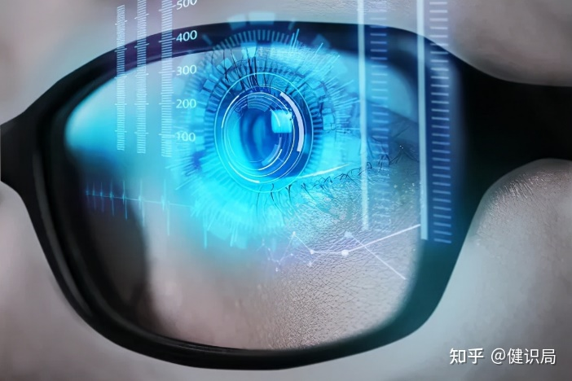
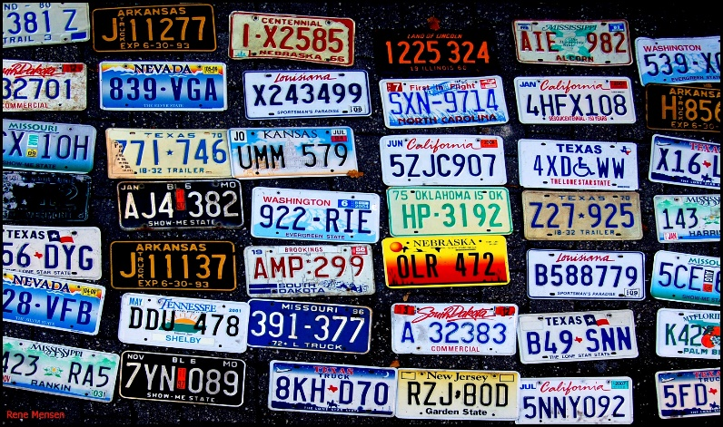
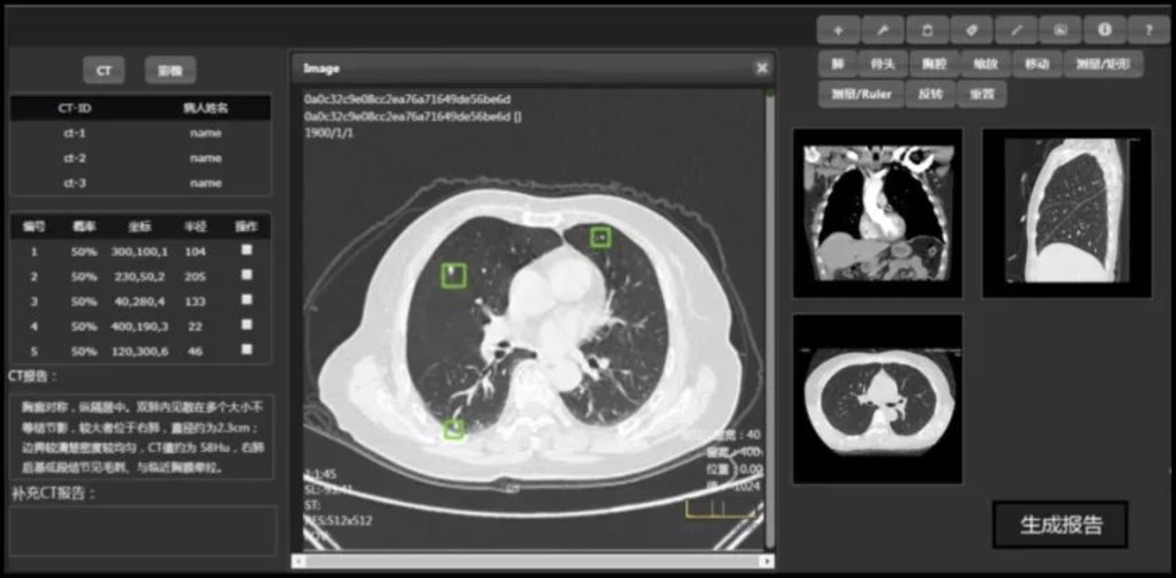
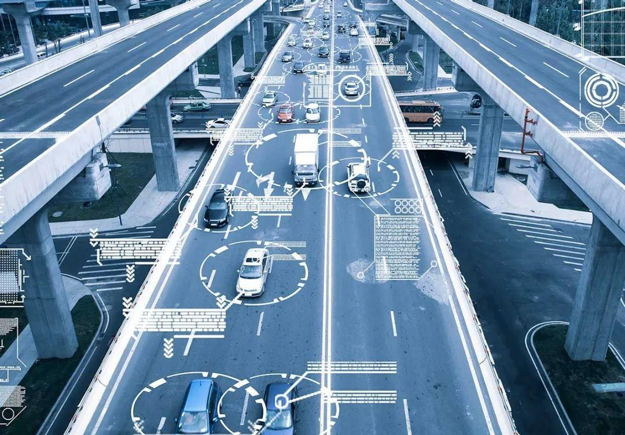
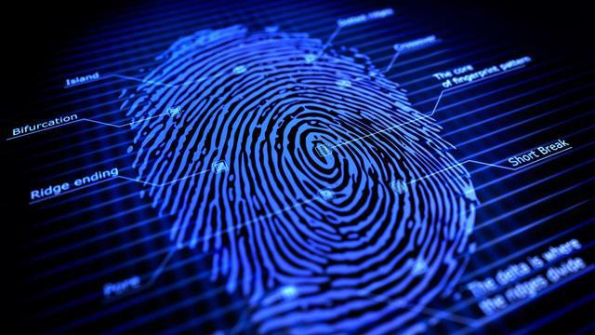
Image Recognition
luly@shanghaitech.edu.cn

Slide 3
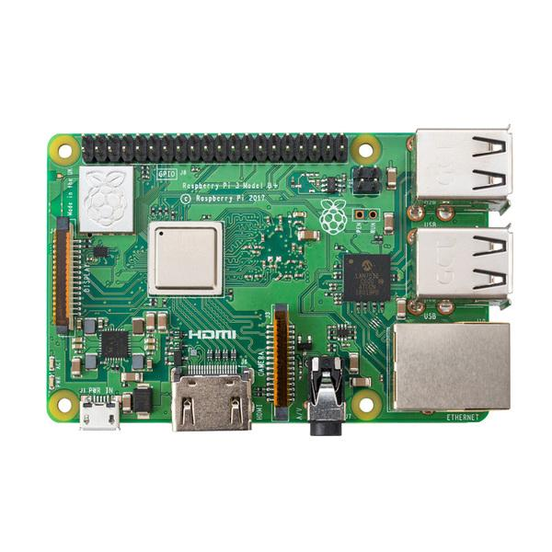
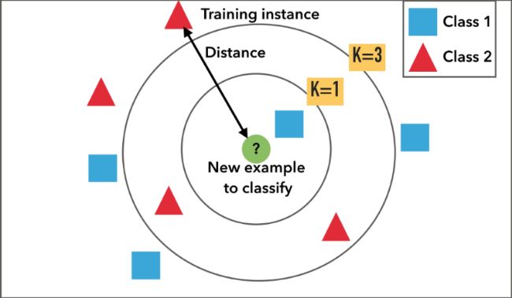
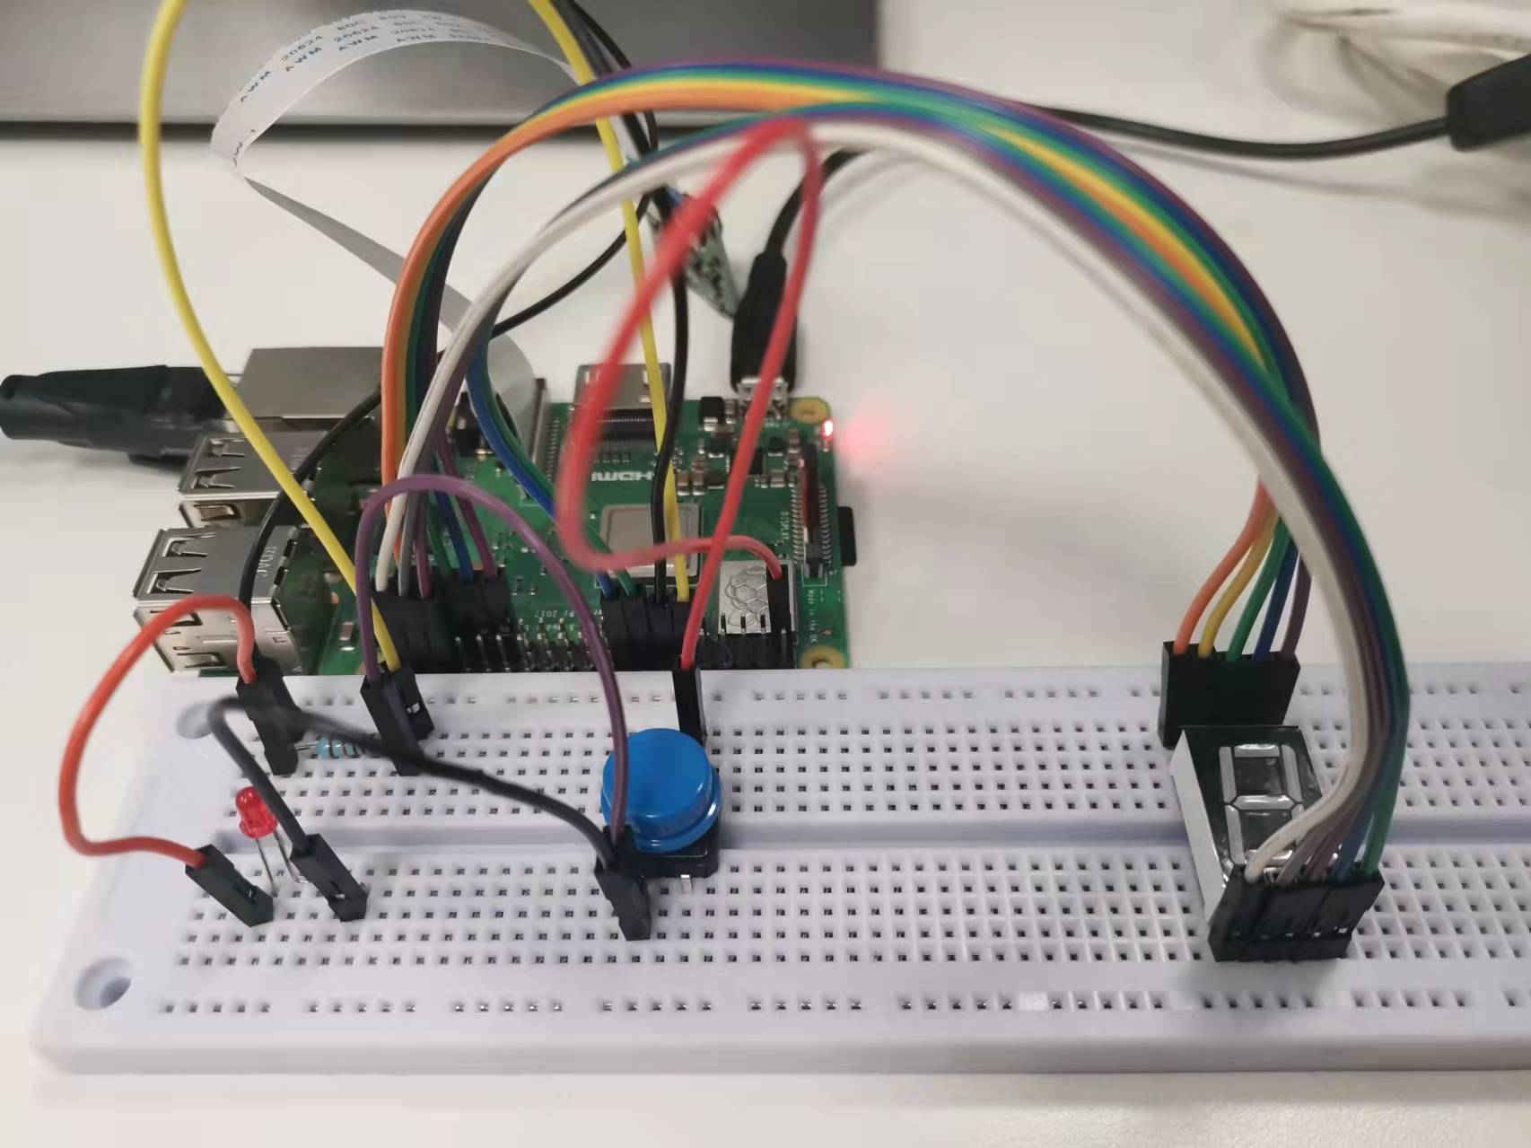
Introduction
Raspberry Pi
Python
Circuit
Remote Control
GPIO
Pi Camera
OpenCV
KNN algorithm
Image Processing
Circuit construction
Digital tube
Camera control
Handwritten Number Recognization
In this project, we will try to perform simple recognition of handwritten numbers. Raspberry Pi will be our platform, on which we will complete operations such as color gamut conversion, segmentation, and denoising of digital images. After that, we will complete the recognition of handwritten numbers based on the KNN algorithm. In addition, we will build a digital tube display circuit to display the results, and a camera control circuit to control the shooting of the camera.

Slide 4
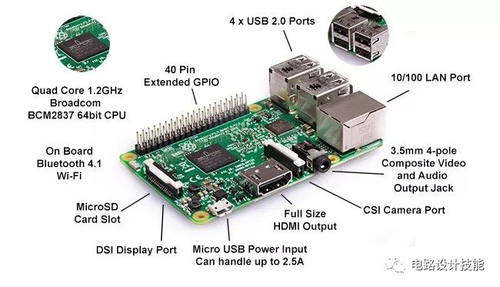
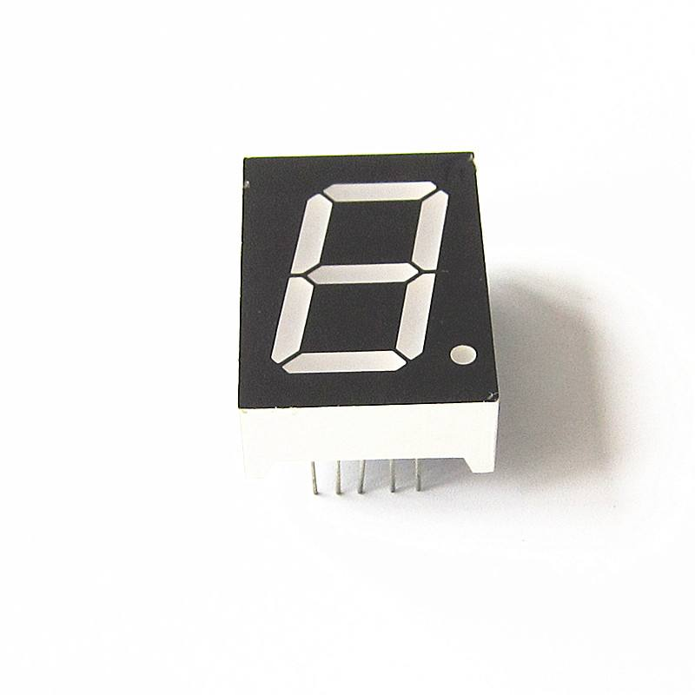
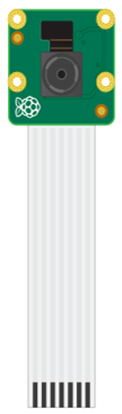
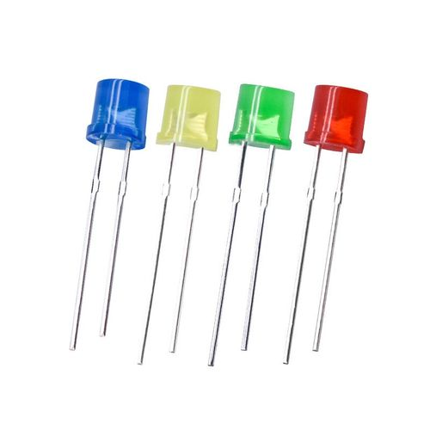
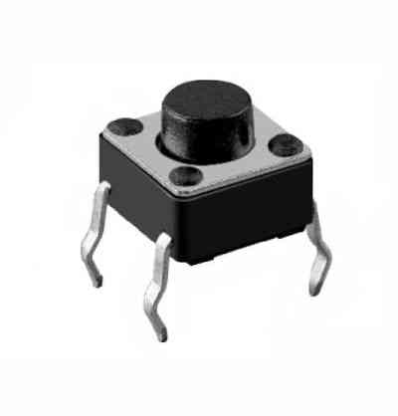
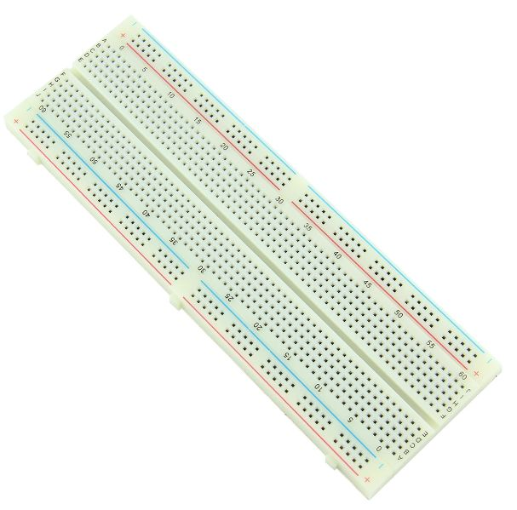
Hardware
Linux commands
  Hareware inspection
  Display Configuration
Remote control
  Control principle
  Command line & Desktop

Slide 5

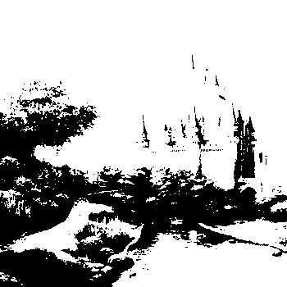
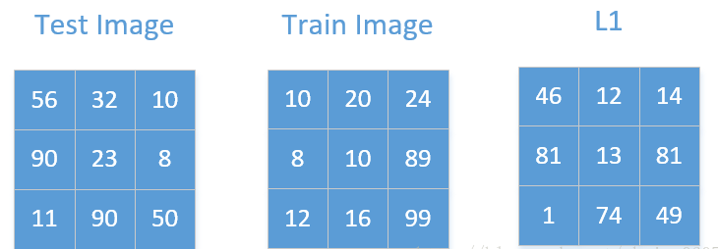
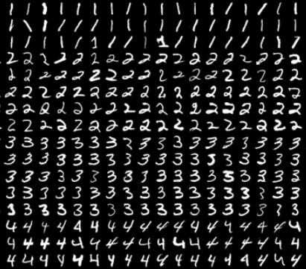
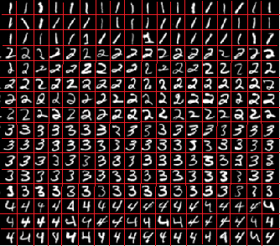
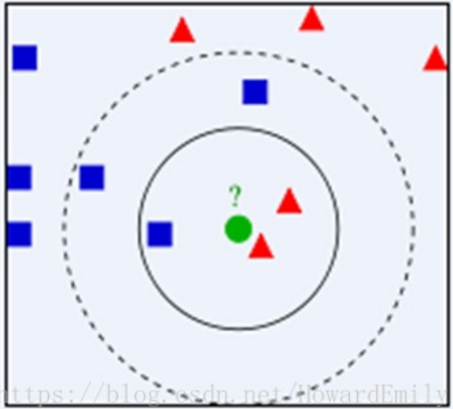

Coding
Image preprocessing
Recognition algorithm
Image segmentation

Slide 6
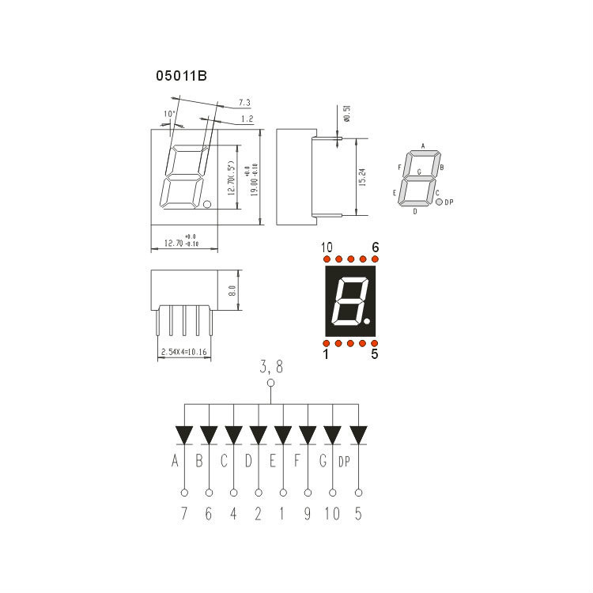
Circuit

Slide 7
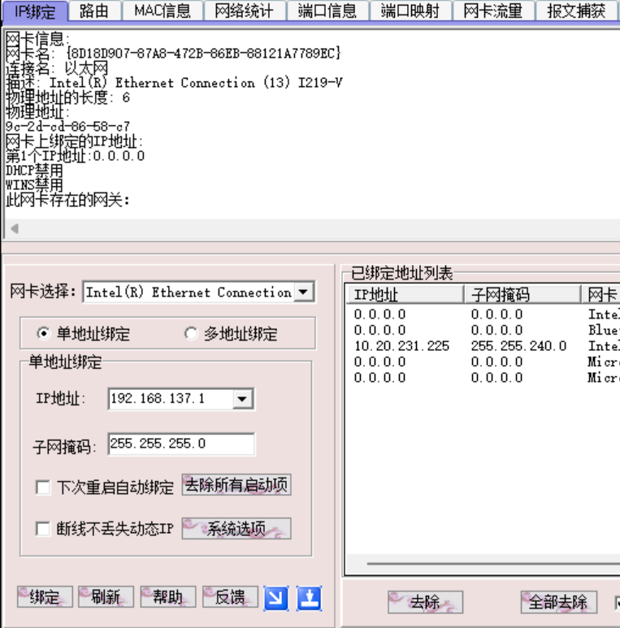
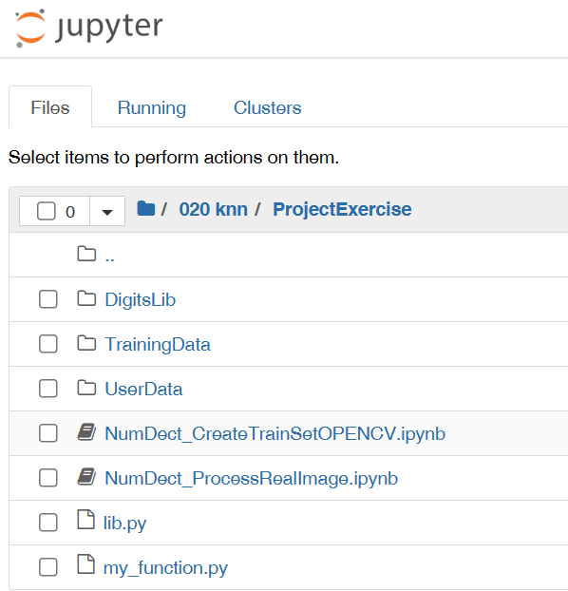
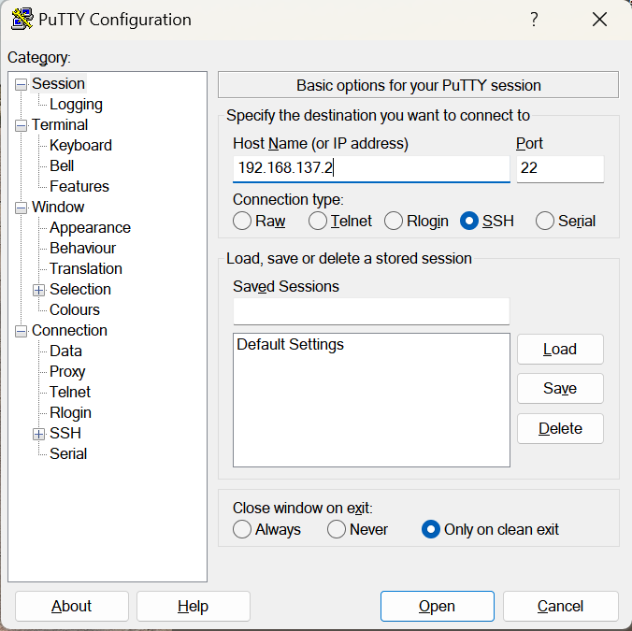
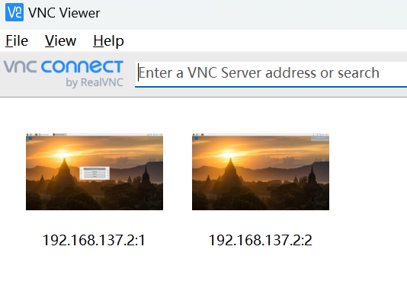
Tools

Slide 8
Tasks
Phanse Task
01
02
03
04
05
06
Training data
Image detecting
Multiline&accuracy
Nixie tube display
Shutter
Real time detect
Extract sample information and generate a dataset.
(10 points)
Image preprocessing and single line recognition.
(20 points)
Multiline recognition and accuracy improvement.
(25 points)
Use Nixie tube to display results.
(8 points)
Build camera control circuit and take real time photos
(7 points)
Real time image acquisition and recognition.
(20 points)
Report (10 points)

